Slide 1


Parking system
management app
Alliance parking

Slide 2

How it works:

Slide 3
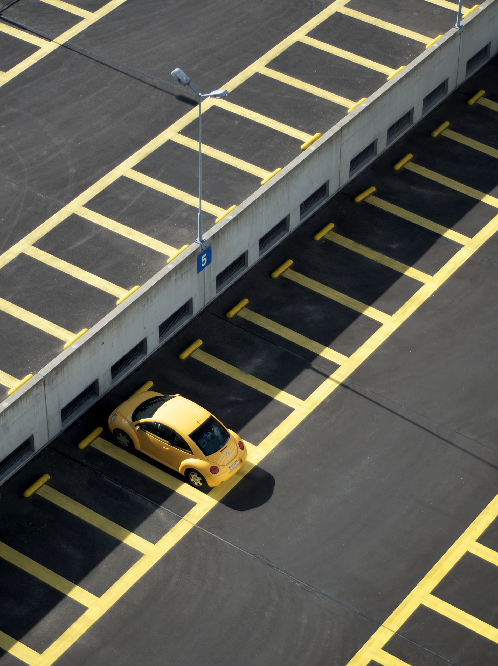
Alliance parking

Slide 5
Alliance parking

